Slide 1
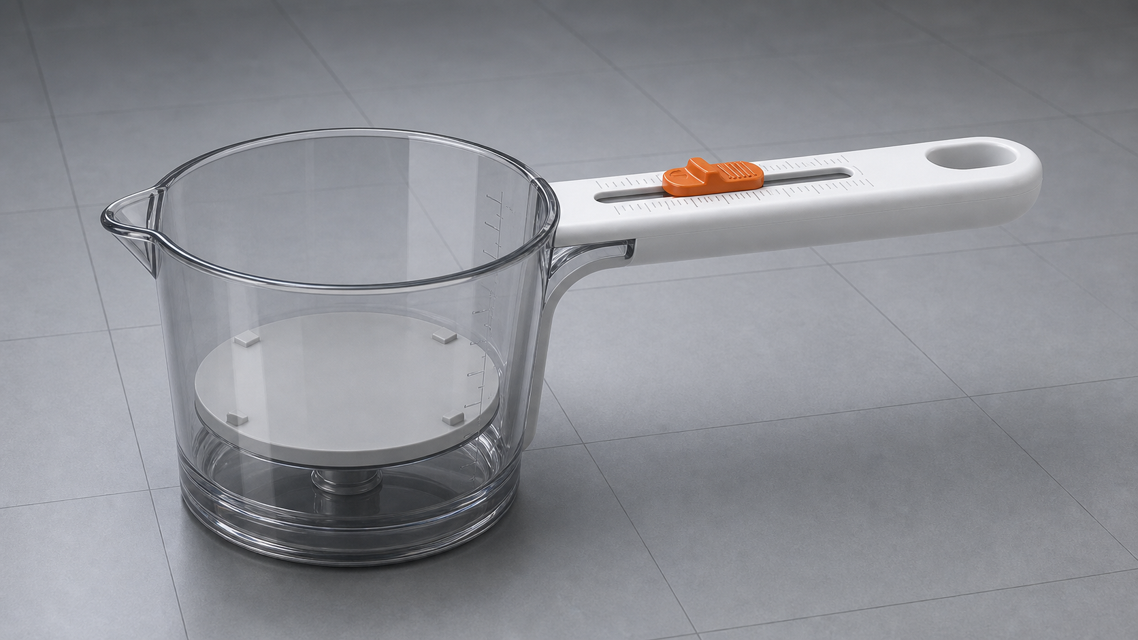
PRODUCT CONCEPT / DRY SOLIDS
Adjustable Spoon-Like Measuring Beaker
A spoon-style dry-goods measuring cup with a transparent beaker head, orange slider, and lockable internal partition.
1
Multi
Lock
Spoon-beaker
Dry-good scales
No slider creep
ADJUSTABLE SPOON-LIKE MEASURING BEAKER
01

Slide 2
EXECUTIVE BRIEF
Spoon-like beaker for dry goods.
The handle slider unlocks and moves the internal partition to set the measured quantity.
01
Dry-solid focus
02
Commercial intent
03
Integrated utility
The design avoids liquid-tight sealing complexity and prioritizes stable particulate isolation.
A premium single-chassis tool for culinary, baking, compact kitchens, and lab material-handling use cases.
Commodity scales, locking slots, and a moving chamber create a differentiated product, not just another cup.
ADJUSTABLE SPOON-LIKE MEASURING BEAKER
02

Slide 3
END PRODUCT VISUAL DESIGN
Spoon-like form, adjustable beaker capacity.
A transparent cup head combines with a straight handle slider and side-linked moving partition.
Straight handle scale
Thumb slider actuator
Locking partition
The visual language now follows the spoon-like measuring beaker form from the student concept.
ADJUSTABLE SPOON-LIKE MEASURING BEAKER
03

Slide 4
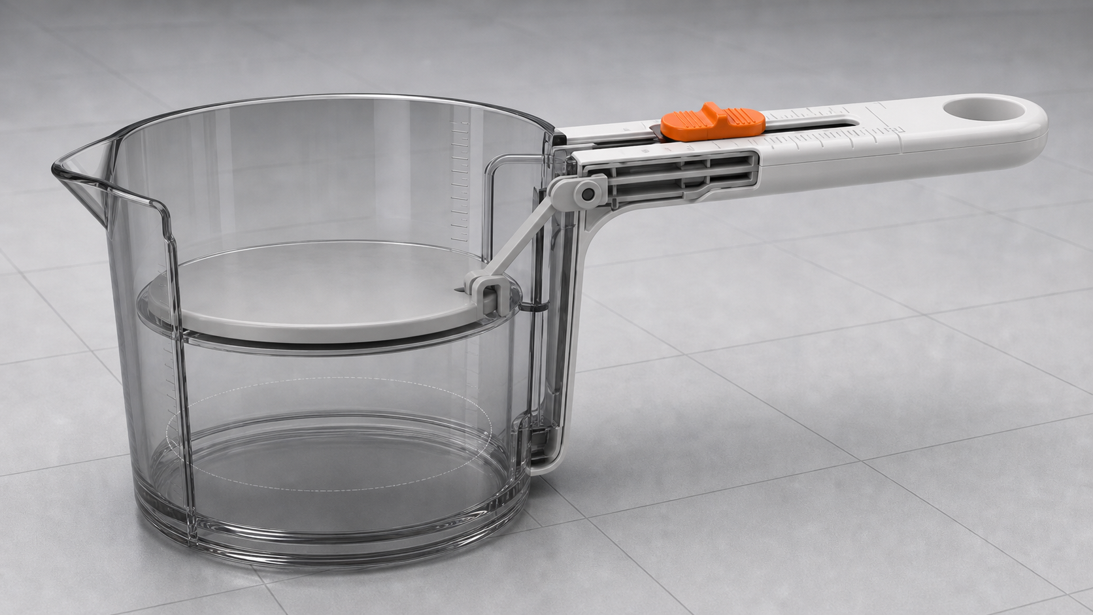
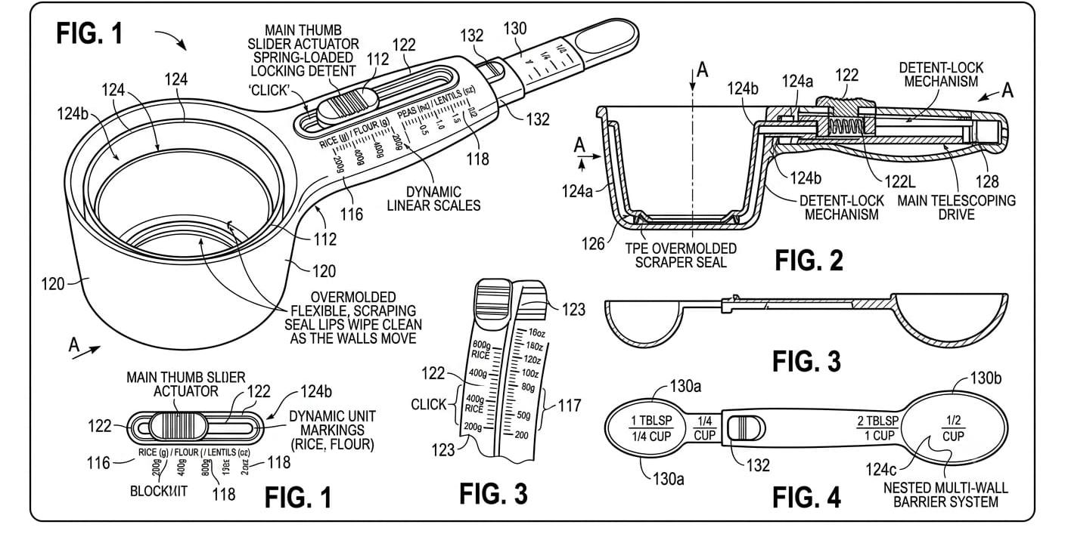
MECHANICAL DESIGN
Spring-loaded slider locks the chamber.
Pressing the orange thumb slider compresses the spring and lifts the locking pin out of its slot.
A
Slider, spring and locking pin
Release the slider and the spring pushes the pin into the nearest locking slot.
B
Sliding partition + scraper seal
The moving partition sets chamber volume while the TPE seal clears grains and powder.
ADJUSTABLE SPOON-LIKE MEASURING BEAKER
04

Slide 5
MATERIALS
Transparent cup. Straight handle. Locking partition.
Materials should support food contact, smooth slider motion, secure pin locking, and residue control.
MAIN BODY
Food-grade polypropylene
SLIDING WALLS
Polypropylene or acetal
SCRAPER SEAL
Thermoplastic elastomer
LOCK PIN
Nylon or stainless steel 304
SPRING
Stainless steel 304
SCALE MARKS
Laser engraving
ADJUSTABLE SPOON-LIKE MEASURING BEAKER
05

Slide 6
4-STEP ADJUSTMENT CYCLE
Press. Slide. Release. Scoop.
Press to unlock the pin, slide to set volume, then release to lock the chamber.
01
Press slider
02
Move partition
03
Release to lock
04
Scoop dry goods
Spring compresses and lifts the locking pin out of the slot.
The internal partition slides to select the required capacity.
The spring pushes the pin into the nearest locking slot.
The locked chamber scoops rice, flour, lentils, or similar solids.
ADJUSTABLE SPOON-LIKE MEASURING BEAKER
06

Slide 7
PRODUCT FEASIBILITY
Dry-solid use makes the sliding partition viable.
The TPE scraper seal clears grains and powder from the sliding path so residue stays out of the mechanism.
01
Reduced seal complexity
02
Mold-friendly architecture
03
Consumer value
The scraper keeps powder and grains away from the guide and lock path.
Cup head, handle, slider, spring pin, slots, and partition can be molded as practical subassemblies.
One locked adjustable chamber replaces several fixed-volume measuring cups.
ADJUSTABLE SPOON-LIKE MEASURING BEAKER
07

Slide 8
PARTS AND ENGINEERING FUNCTIONS
Parts behind the spoon-beaker mechanism.
Every component supports control, cleanability, and measurement clarity.
CUP CHAMBER
Transparent measuring chamber with small spout.
HANDLE SCALE
Rice, flour, gram and ml markings.
THUMB SLIDER
Pressing it compresses the spring and lifts the locking pin.
LOCKING PIN
Spring returns the pin into the nearest locking slot.
SLIDING PARTITION
Moves along the guide path to set measuring volume.
TPE SCRAPER SEAL
Clears grains and powder from the sliding path.
ADJUSTABLE SPOON-LIKE MEASURING BEAKER
08

Slide 9
WORKING MODEL DIRECTION
Prototype-ready story: spring lock, sliding chamber, calibrated quantity.
The next iteration should validate slider feel, particle wipe performance, chamber tolerance, and scale readability across common dry commodities.
Prototype validation targets
Slider force | Pin lock | Slot accuracy | Scraper wear | Powder residue | Scale readability
ADJUSTABLE SPOON-LIKE MEASURING BEAKER
09

Slide 10
